Slide 1


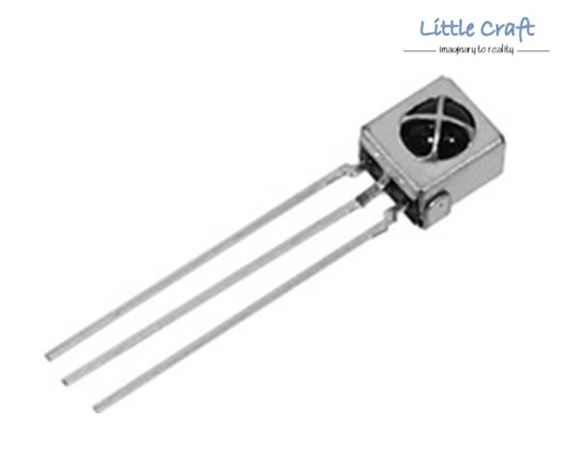
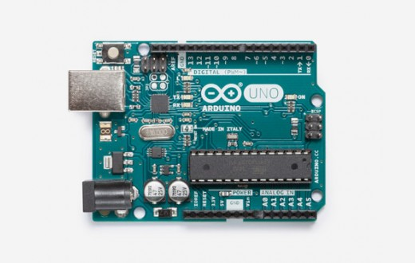


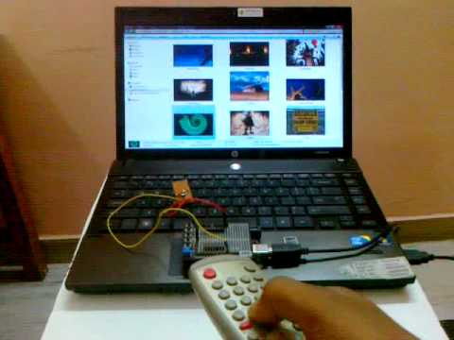
REM-MOUSE
-Remote as a mouse
Technical Board IIT Guwahati
Bipin | Swapnil |Shivashish|Shiddharth|Yash|Prathik|
Sai Kumar|Sayan
Electronics Club
IIT Guwahati
INTRODUCTION
Using TV remote as a PC mouse seems not a very good idea but it is.This will help the people in controlling their laptops/PC while giving a presentation over projectors.
WORKING
IR SENSOR : It receives the signal from remote.
ARDUINO : It detects the hash code of the signal and sends it to program.
PYTHON PROGRAM reads the hash code and detects the command given by user and makes the cursor act accordingly.
MATERIALS AND METHODS
We have used an IR sensor which detects the command given by user (like to move the cursor up) and sends it to arduino micro –controller . We have made a program that uses the hash codes for different commands. Program will detect which command is given and will make the cursor act accordingly.
Receiving the IR signal
Decoding the hash code and sending it to our program
Cursor acts accordingly
Detecting which command has been given
WORKING PRINCIPLES
Design
REFERENCES
CONTACT

